Slide 1
Service
“ a method for exposing a network application that is running as one or more Pods in your cluster”

Slide 2
Demo k8s/03_service/multiple_services.yaml (DNS resolution)

Slide 3
Service vs Deployment

Slide 4
DevOps perspective:
microservice = k8s Service
Developer perspective:
microservice = k8s Deployment
Service = it’s mainly about networking
Deployment = it’s mainly about a workload

Slide 5
Ingress
“lets you map traffic to different backends”

Slide 6
Service = handles just 1 Deployment
Ingress – handles 1..N Deployments (via Services)

Slide 7
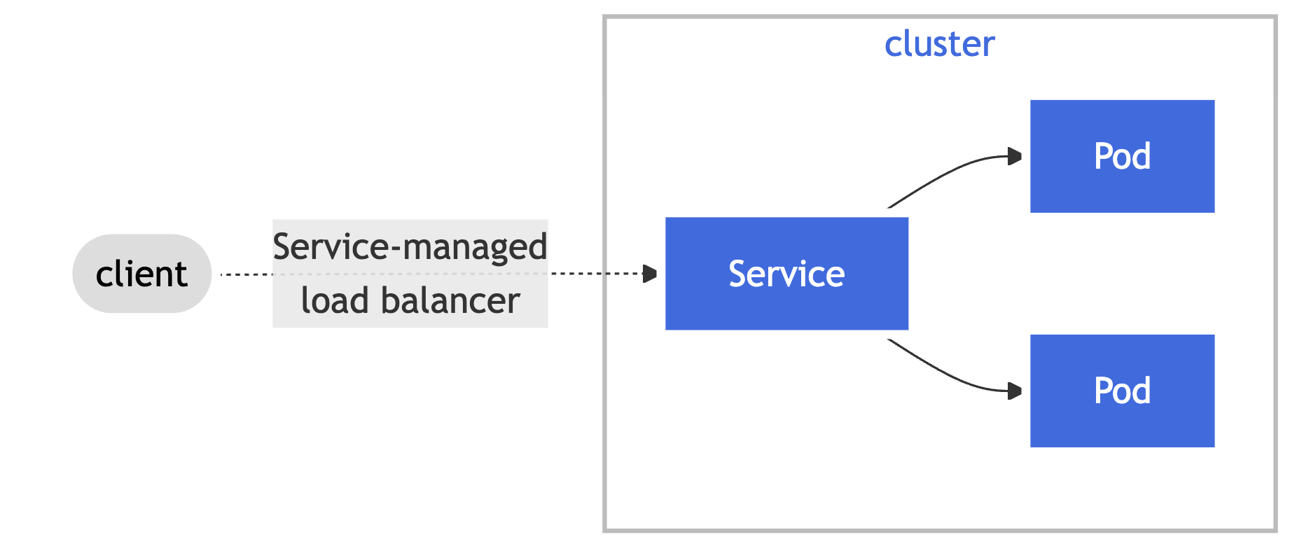
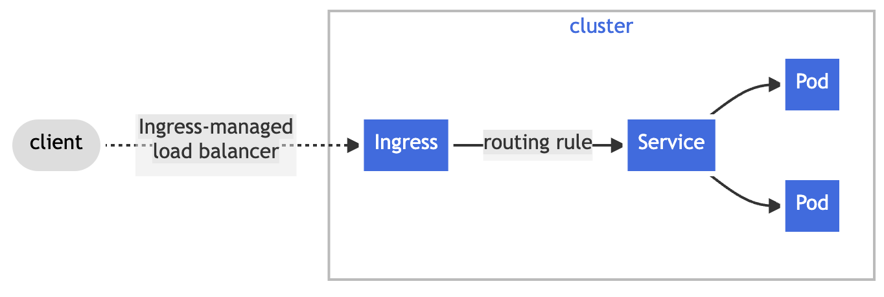
Ingress vs Service

Slide 8
Demo k8s/04_ingress/two_services.yaml

Slide 9
Service Accounts
“Application Pods, system components, […] can use a specific ServiceAccount's credentials to identify as that ServiceAccount.” i.e Pods can identify as a specific ServiceAccount

Slide 10
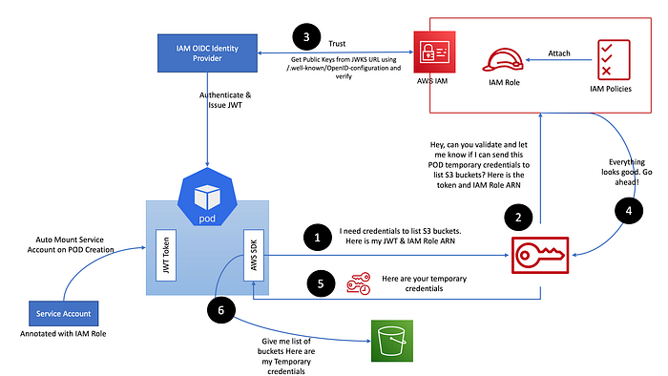
IRSA = IAM Roles for Service Accounts
Source: [Diagram1]

Slide 11
Amazon EKS Pod Identity Webhook
ServiceAccount (sa-test) annotated with:
eks.amazonaws.com/role-arn: "arn:aws:iam::{account-id}:role/{iam-role}"
(new) Pod using:
spec.serviceAccountName: sa-test
Injections (by web hook):
Environment variables:
- AWS_DEFAULT_REGION
- AWS_REGION
- AWS_ROLE_ARN
- AWS_WEB_IDENTITY_TOKEN_FILE
- AWS_STS_REGIONAL_ENDPOINTS
Volumes:
- var/run/secrets/eks.amazonaws.com/serviceaccount/token

Slide 12
val client = S3Client .builder().credentialsProvider( StsAssumeRoleWithWebIdentityCredentialsProvider.builder().build() ) .region(US_EAST_1) .build()
private StsWebIdentityTokenFileCredentialsProvider(Builder builder) { super(builder, "sts-assume-role-with-web-identity-credentials-provider"); Path webIdentityTokenFile = builder.webIdentityTokenFile != null
? builder.webIdentityTokenFile : Paths.get(
trim(
SdkSystemSetting.AWS_WEB_IDENTITY_TOKEN_FILE.getStringValueOrThrow()
)
);

Slide 13
Demo aws/create/7_setup_irsa.sh k8s/05_irsa

Slide 14
Helm
package manager for Kubernetes

Slide 15
A Chart is a Helm package
(Helm uses a packaging format called charts. A chart is a collection of files that describe a related set of Kubernetes resources.)
[used by UP]
A Repository is the place where charts can be collected and shared
[not used by UP]
A Release is an instance of a chart running in a Kubernetes cluster.
[not used by UP]
Source: [Docs2]

Slide 16
User Platform facilitates only one command of Helm (under the hood – it is called by ArgoCD):
helm template

Slide 17
GO templates
https://pkg.go.dev/text/template (engine)
https://pkg.go.dev/github.com/Masterminds/sprig (extra template functions - supported out of the box)
"Actions"--data evaluations or control structures--are delimited by "{{" and "}}";
all text outside actions is copied to the output unchanged.
Source: [Docs2]

Slide 18
Demo aws/create/5_create_ingress_controller.sh aws/create/8_install_keda.sh (as regular package manager: helm install)

Slide 19
Demo k8s/06_helm (helm template)

Slide 20
ArgoCD
continuous delivery tool for Kubernetes

Slide 21
Target state (github)
Live state (kubernetes cluster)
Sync

Slide 22
Demo k8s/07_argo

Slide 23
UP applications setup in EKS
ApplicationSet – generator #1 (tenants)
(line 23: - path: "applications/eu-west-1/*.yaml” )
UP applications - input to #1 generator
ApplicationSet – generator #2
(line 18: {{- range $d := .Values.destinations }} )
UP environments – input to #2 generator

Slide 24
ApplicationSet
(use1-up)
Application
(use1-up-stream-concurrency)
ApplicationSet
(use1-up-stream-concurrency-environments)
Application
(use1-up-stream-concurrency-qa)
Link to ArgoCD
Generates 3 Applications
Application
(use1-up-stream-concurrency-perf)
Application
(use1-up-stream-concurrency-prod)
Generates 41 Applications
Application
(use1-up-synthetic-monitor)
ApplicationSet
(use1-up-synthetic-monitor-environments)
Application
(use1-up- synthetic-monitor-qa)
Generates 2 Applications
Application
(use1-up- synthetic-monitor-prod)
…

Slide 25
Demo apply change in GH repo (source) and see changes reflected in k8s cluster (target)

Slide 26
UP pull request merge
{
helm_values_file: braze-integration/use1-qa.yaml,
key_to_update: pod.containers.braze-integration.image,
container_image: […].[…]/up-braze-integration:0.1.290,
patch_values: {
pod: {
containers: {
braze-integration: {
environmentVariables: {
NR_VERSION: 0.1.290
}}}}}
utilities/eks-rolling-update-deploy :
Cloning repository https://[...]/viacomcbs/up-k8s-applications.git
python3 -u argocd-update-helm-values.py
git commit […]
git push --set-upstream origin main
python3 -u argocd-deployment-validation.py
def restart_argocd_application(argocd_server, argocd_app, token): token_opt = f"--auth-token={token}" command = " ".join([ f"argocd app actions run {argocd_app}", "restart --kind Deployment", f"{token_opt if token != '' else ''}", f"--server {argocd_server}", "--grpc-web", ])
! Triggers Kubernetes rolling update
argocd app actions run use1-up-braze-integration-qa restart \ --kind Deployment {token_opt} \ --server {argocd_server} \ --grpc-web

Slide 27
UP service restart (e.g. after configuration change)
user-platform/up-eks-application-restart
! Triggers Kubernetes rolling update
utilities/argocd-restart-application
argocd app actions run use1-up-braze-integration-qa restart \ --kind Deployment --all '--auth-token=****’ \ --server argocd.tools.paramount.tech \ --grpc-web

Slide 28
UP ‘perf’ service horizontal scaling
user-platform/up-scale-perf-eks-services:
Cloning repository https://[...]/viacomcbs/up-k8s-applications.git
sed -i '/replicas:/s/:.*/: 0/' api-gateway/use1-perf.yaml
git commit […]
git push
! ArgoCD autosync triggers Kubernetes rolling update

Slide 29
UP autoscaling (Keda)
Open a PR for the service that needs an autoscaling change:
E.g. https://github.com/viacomcbs/up-k8s-applications/blob/main/activation-code/use1-prod.yaml
Merge PR
Wait for changes to be picked up by ArgoCD autosync
autoscaling:
keda:
enabled: true
maxReplicas: 64
minReplicas: *replicas
pollingInterval: 60
advancedBehavior:
scaleUp:
stabilizationWindowSeconds: 120

Slide 30
Keda

Slide 31
Sources
Docs1 - https://kubernetes.io/docs/home/
Docs2 - https://helm.sh/docs/topics/charts/
Docs3 - https://argo-cd.readthedocs.io/en/stable/
Diagram1 [IRSA] - https://mohaamer5.medium.com/iam-roles-for-service-accounts-with-eks-irsa-good-bye-aws-credentials-1cdf1fa5192

Slide 32
Terraform

